Slide 1
POPs, Hazardous Waste, and Gender-Dimensions in Kyrgyzstan
Findings of the scoping study on Gender, Chemicals and Waste for the BRS secretariat
HLPF 7 July 2021
Indira Zhakipova
Expert for BIOM
EKOIS Kyrgyzstan
Anna Kirilenko
Executive Director
BIOM Kyrgyzstan

Slide 2
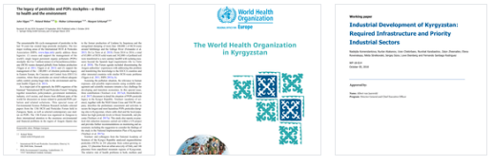
Desk Research Study

Slide 3
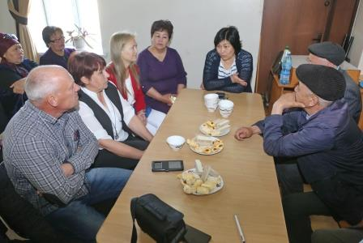
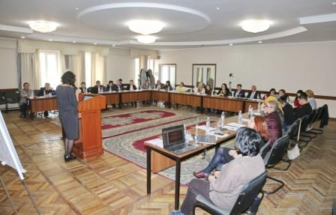
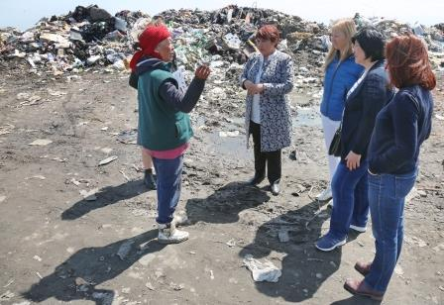
METHODOLOGY
As part of the scoping study were organized: desk research study, stakeholder dialogue meeting and site visits and interviews
Visits and interviews
leading scientists
national authorities
United Nations
waste scavengers
village councillors
a recycling company
a wastewater plant
Photos: Vladishlav Ushakov, BIOM/WECF

Slide 4
National strategic frameworks related to Gender & Chemicals, Waste
National Implementation Plan of Stockholm Convention 2006, 2017-2019 годы, does not have any gender-responsive measures.
National Strategy of the Kyrgyz Republic on Achieving Gender Equality up to 2030 is updated but is still not approved by Government
The Law of the Kyrgyz Republic “On State Guarantees of Equal Rights and Equal Opportunities for Men and Women”, stipulates the integration of a gender approach into state, regional and local development programs and strategies. It aims also at gender equality in staffing and for land rights .
Gender aspects have been introduced into the «Green economy program”, based on this study
Notes:
Access NIPs not always easy

Slide 5
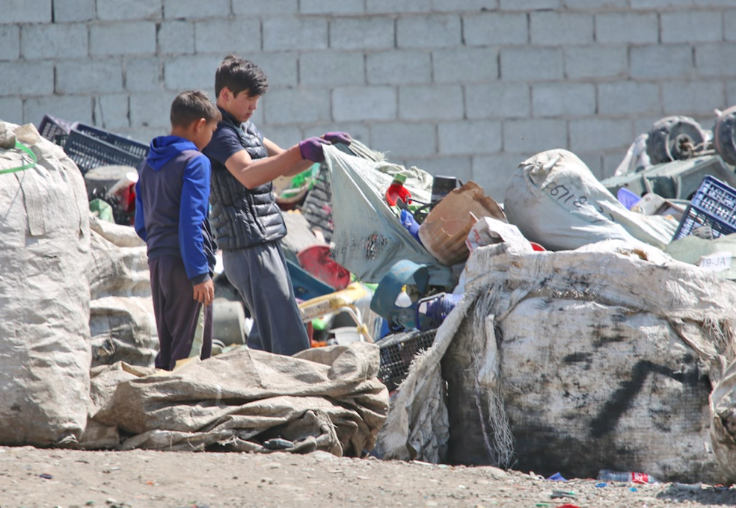
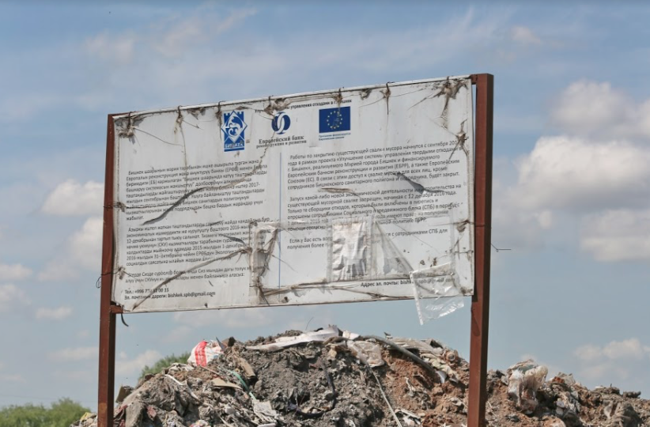
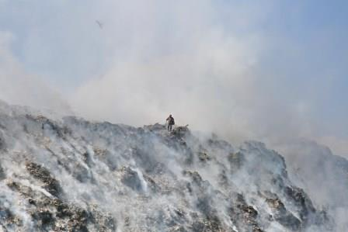
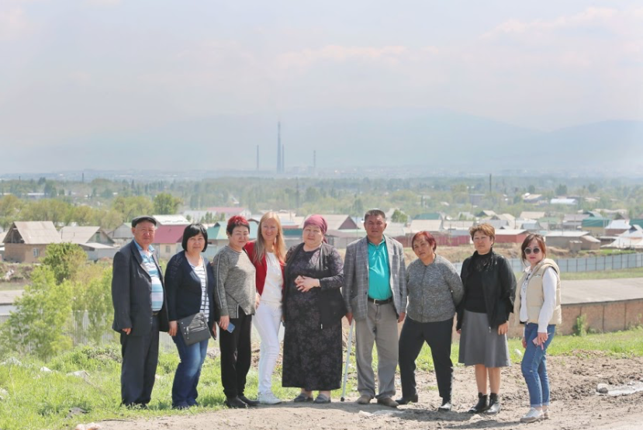

Slide 6
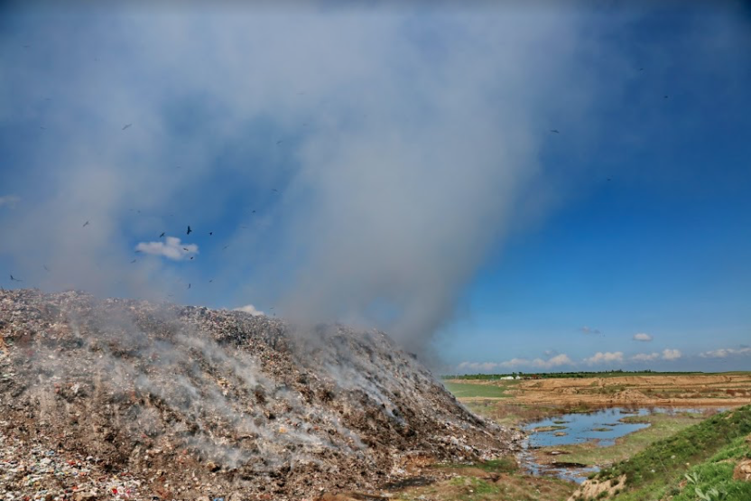
Gender dimensions of Waste and (new) POPs
The State Committee for Ecology and Climate discovered 299 unauthorized landfills in 2018 during the inventory of landfills in Kyrgyzstan

Slide 7
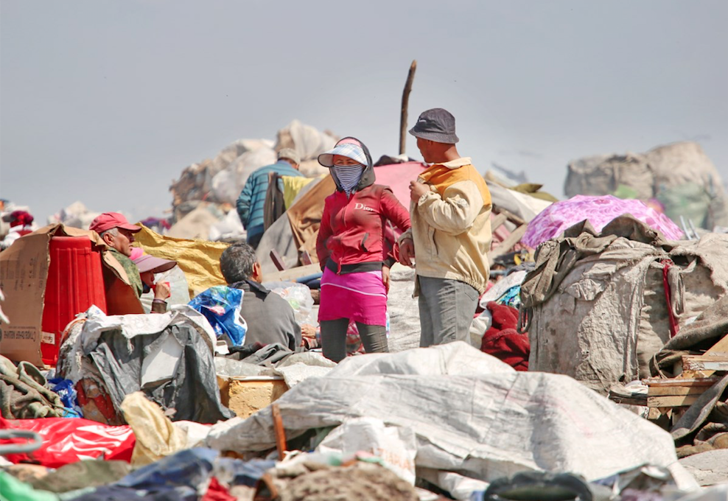
Man and women and children do informal work and live arround the dumpsites

Slide 8
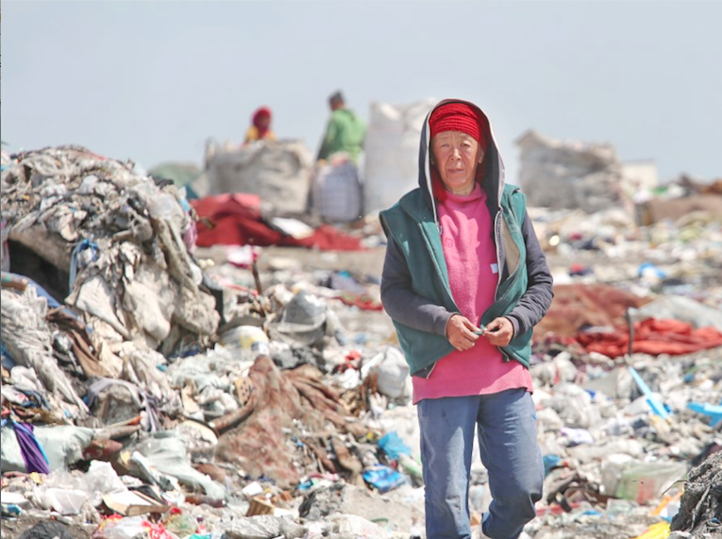
Example of a woman is a single income provider for her family

Slide 9
* Source: UN Contrade database: https://comtrade.un.org/data/ As reported by Kyrgyzstan

Slide 10
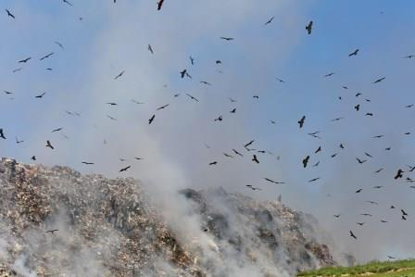
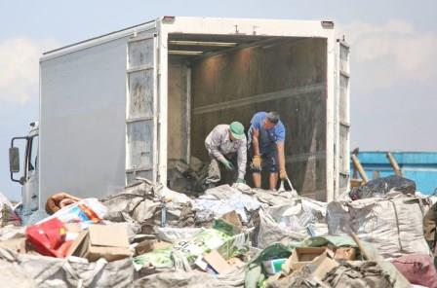
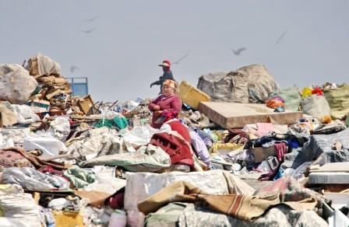
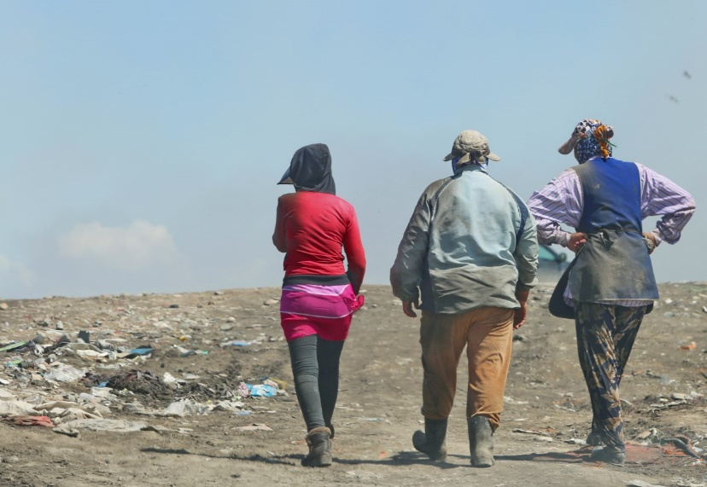
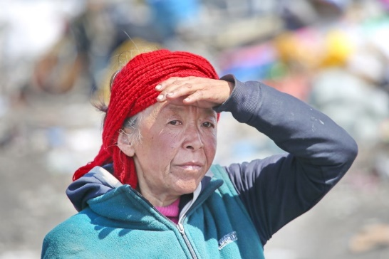
Dioxins and other POPs from waste
Men, women and children are involved in sorting garbage in landfills (according to expert estimates women are around 60%)
Food, plastic, metal, cardboard, glass are being collected
No health studies have been conducted on the chemical cocktail of pollutants, waste workers are unaware of risks
Landfills are a source of unintentional emission of POPs such as dioxins due to the on-going burning of garbage
Waste during collection is not sorted. Medical, electronic, household, food waste are dumped, often illegally.
Toxics are spreading into water (fishing) and air (over nearby villages, over farm fields, all the way to Bishkek)

Slide 11
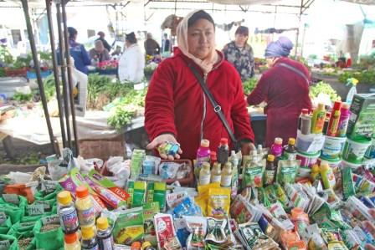
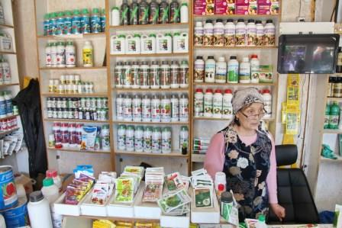
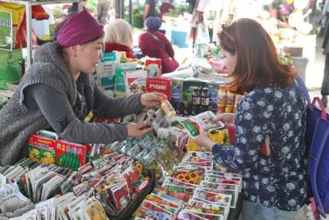
Informal pesticides trade
Gender aspects can be linked to many pesticide sellers are women

Slide 12
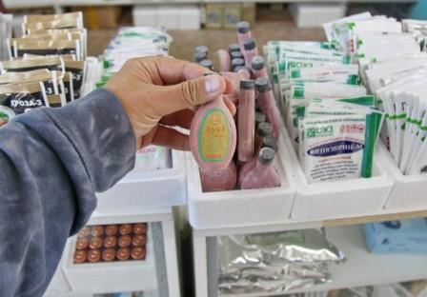
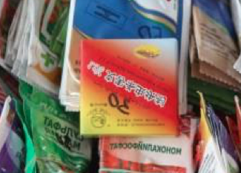
Informal pesticides trade
Gender aspects Can be linked to:
Awareness raising on health impacts on family, costs and burden of care
Factual information on the marketing slogans used e.g. “this is great DDT” (DOOST in Russian)
Understanding indirect contamination through storage, washing, playing of kids etc.

Slide 13
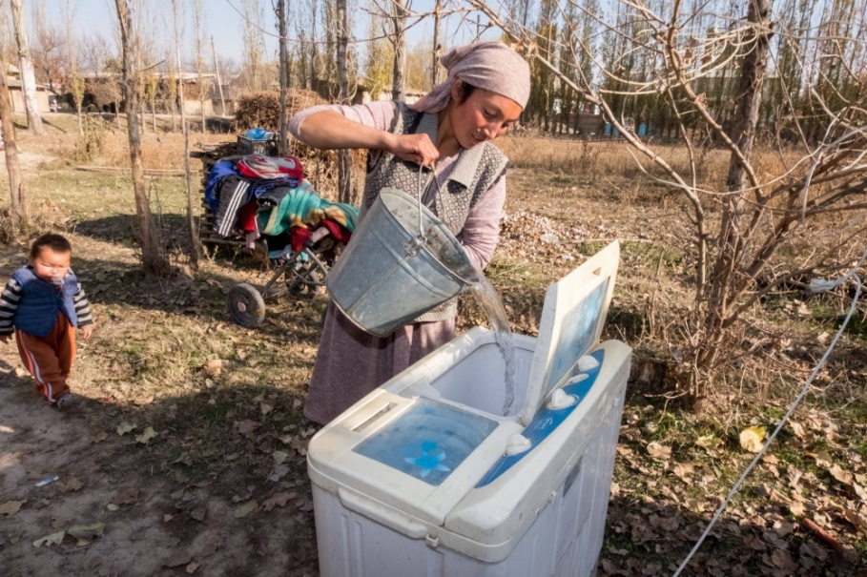
Gender-disaggregated data on pesticide use
Women and children are indirectly exposed to pesticides
Фото: https://kaktus.media

Slide 14
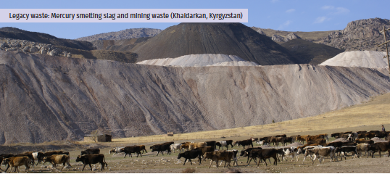
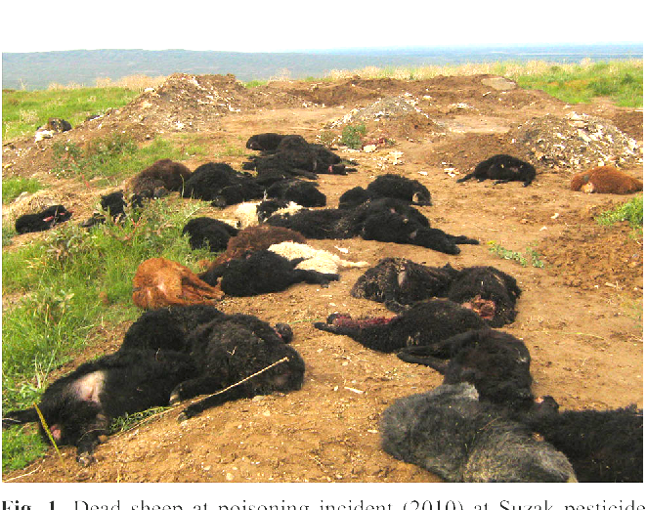
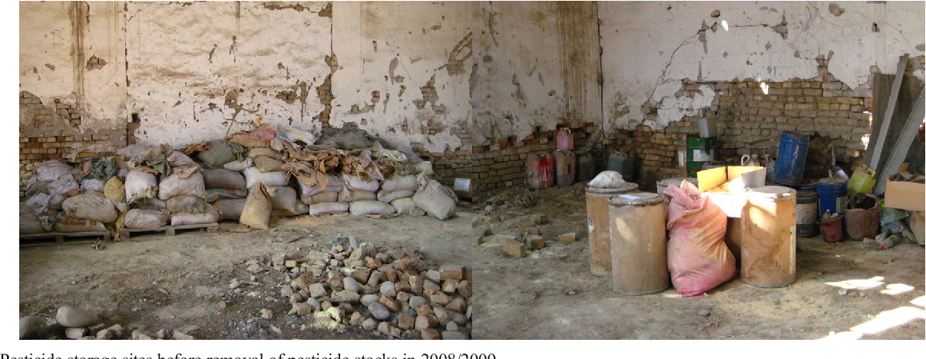
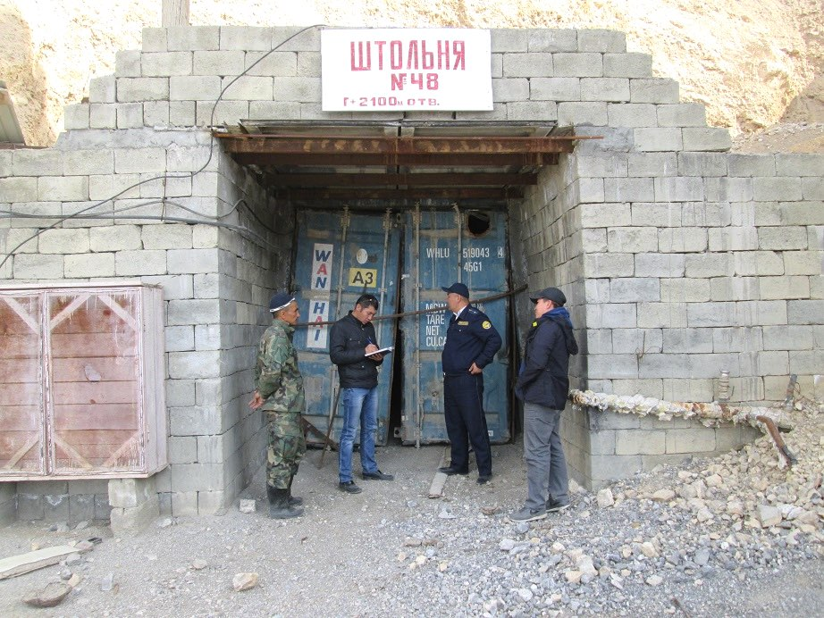
Legacies: POPs dumps, mercury, uranium
Photo credit: Zoi Environment Network
https://www.semanticscholar.org/paper/Assessment-and-review-of-organochlorine-pesticide-Toichuev-Zhilova/9fdc8033783b4017e7a92a68b33d5e5cf99d5c5a
Photos 2,3,a,b: Indira Zhakipova

Slide 15
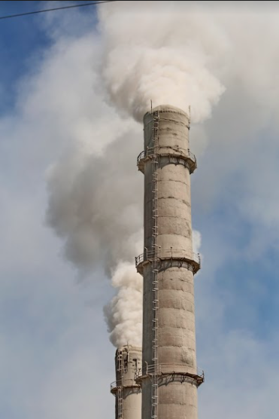
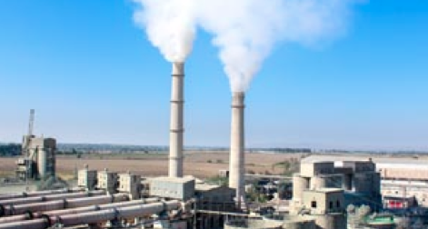
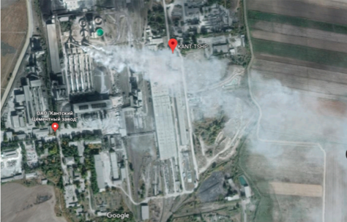
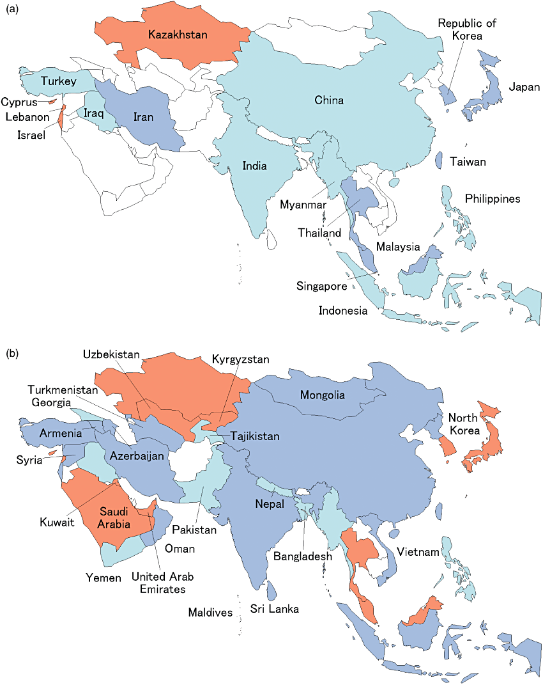
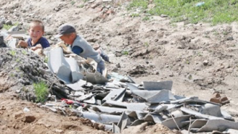
Chrysotile Asbestos
KYZ still has an operating asbestos-cement factory in Kant
Low-income families use asbestos
Asbestos dust covers surrounding fields
Gender aspects
Kazakhstan
Children playing in asbestos waste: KYZ has no safe handling of asbestos waste
Respirology, Volume: 16, Issue: 5, Pages: 767-775, First published: 30 March 2011, DOI: (10.1111/j.1440-1843.2011.01975.x)

Slide 16
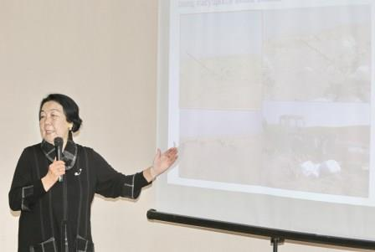
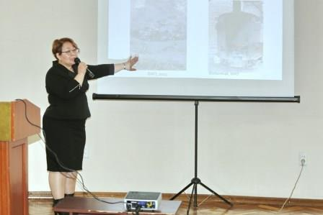
GOOD PRACTICES IDENTIFIED
UNDP Project to protect health workers from unintentional releases of POPs and mercury: 80% of health workers in pilot health facilities were women (reduced impact of POPs, mercury, infections)
Kyrgyz-Turkish Manas University did study on bioremediation, select destructive microorganisms for pesticide degradation, to use selected bacteria for bioremediation of highly polluted soils around burial sites it will have positive health impacts for women, men, children it can be used to clean up contaminated sites in villages
Ministry of Emergency Situations Developed a departmental plan on gender equality and a Standing Commission on gender.
Initiatives to promote community-run recycling and PET bottles collection
The Parliament adopted law to switch to organic farming till 2030
The State Committee proposed a ban on Single Use Plastics (April’19) which was not approved unfortunately

Slide 17
Recommendations (cont.)
The National Implementation Plans for BRS should include women as actors as well as concrete gender-responsive activities
Gender disaggregated data is needed on different levels
All ministries and agencies should use gender tools including formats for budgeting and reporting
Set targets for gender balance in decision-making
Human health is essential, apply precautionary principles to new POPs as PFOA to reduce the risks of pollution in everyday life
Involvement of gender, human rights and environmental activists in projects

Slide 18
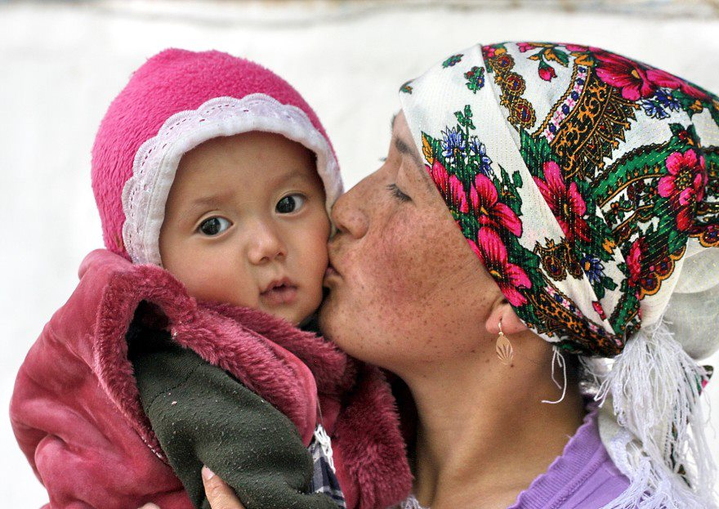
Thank you for attention
www.biom.kg

